Slide 1

Hierarchical Attention Graph Convolutional Network

Slide 2
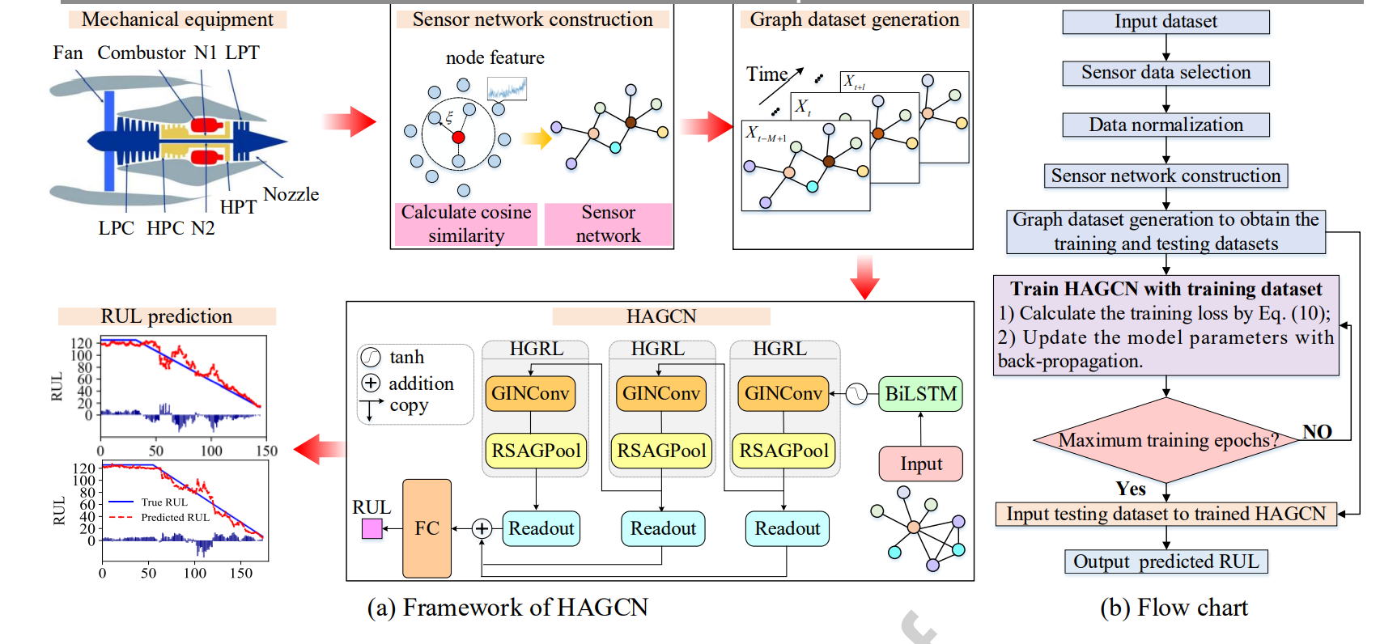
Overview
Li, Tianfu, et al. "Hierarchical Attention Graph Convolutional Network to Fuse Multi-sensor Signals for Remaining Useful Life Prediction." Reliability Engineering & System Safety (2021): 107878.

Slide 3
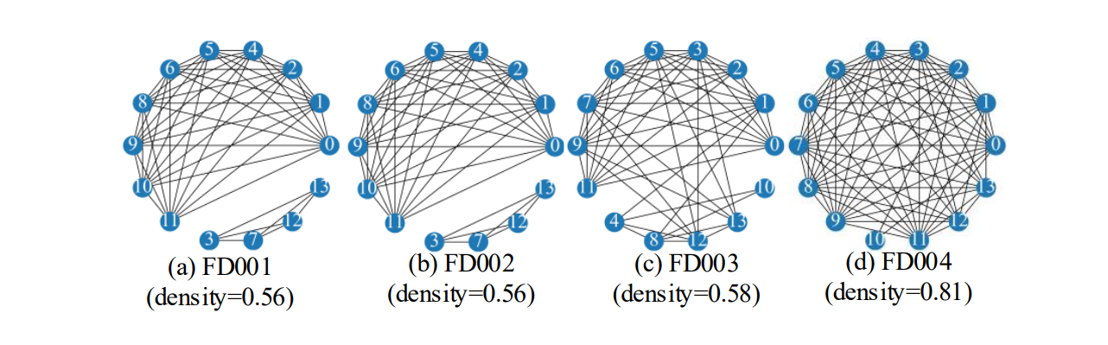
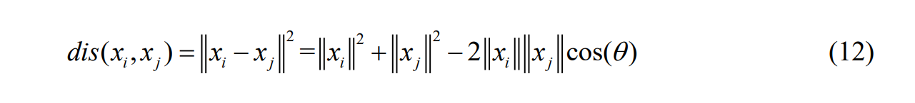
Highlight- Graph Establishment

Slide 4
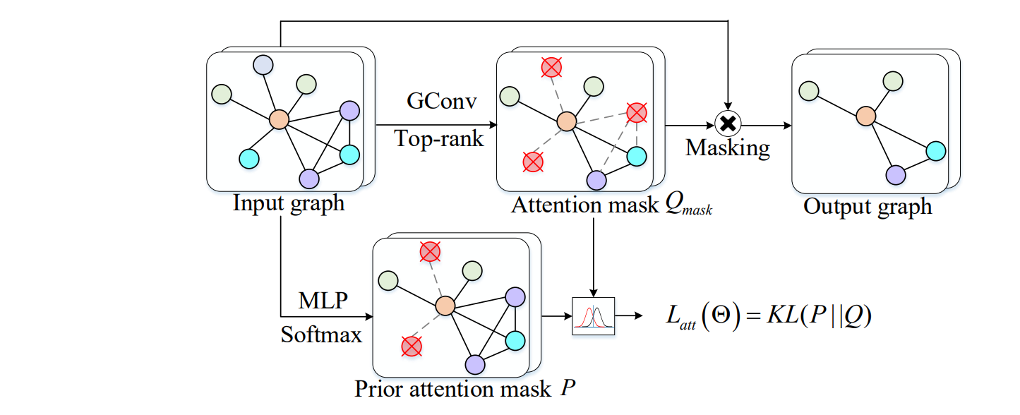
Highlight

Slide 5
Inspiration - Graph
A graph can be aggregated from a time-series data. Here the author use one sensor data to create a node and count on the auto-encoding process of the deep-learning method. We can build nodes based on each extracted feature.
The author build the graph’s edges based on cos-similarity. We can let it be the correlation between features.

Slide 6
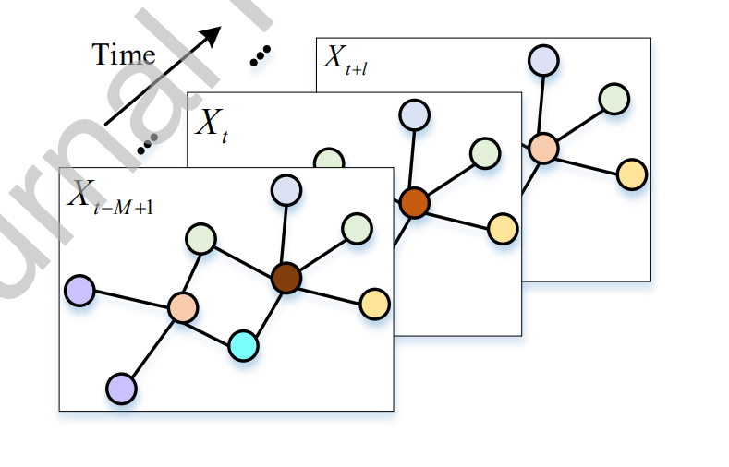
Inspiration – Convolution & LSTM
The author find a way to combine the LSTM together with graph-self-attention convolution layers.
In my opinion, it is better to do HGRL first and then put it into the Bi-LSTM model.

Slide 7
Inspiration Self-attention
Self-attention can be introduced to the convolutional layers, which can help interpret the model and decrease complexity.

Slide 8

Thank you!

